Slide 1
Safety and Security at WCCC
2018 orientation presentation

Slide 2
Welcome. We are happy you are here
I’ll be quickly reviewing some things we have to help secure you while you’re here.
First, Let me give you three quick tasks you can do to start your safety and security program at WCCC

Slide 3
1. Get an id (see the library)

Slide 4
2. If you drive, also pick up a parking pass

Slide 5
2. Sign up for rave (emergency alert system]

Slide 6
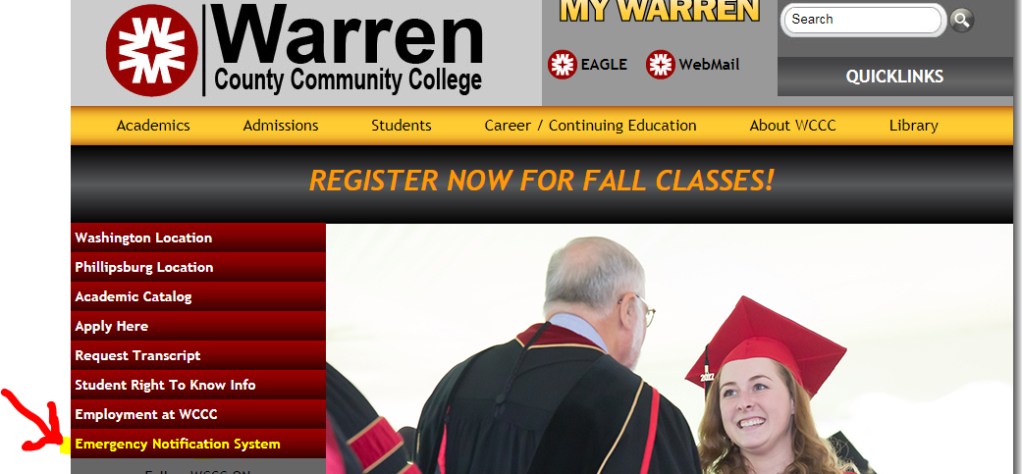
Rave System

Slide 7
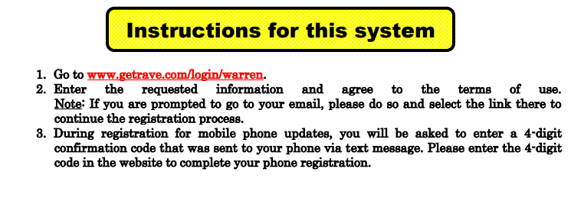
Sign up to receive texts or e-mails

Slide 8
Why rave is important
If there is an issue at the college, we will activate rave
Most common use has been for snow closing/delayed opening but we’ve also notified students in cases of power failures, any regional car accidents, security drills, etc.

Slide 9
View the security information
In your handbook
On our website homepage (first item in Quicklinks dropdown)
Also information is under student right to know on the home page

Slide 10
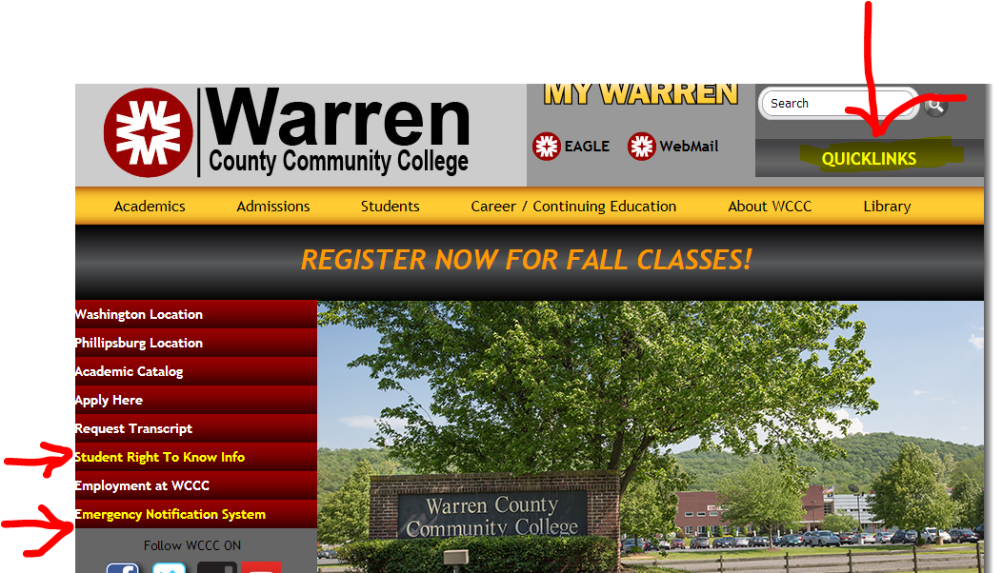

Slide 11
Common sense parking
Be careful pulling in and turning out of driveway & parking areas
If you are taking late afternoon or evening classes, try to park in the main lot where lighting is better
Use cross walks (especially during class changeover period)
Please let security know if there are any issues

Slide 12
Safety inside the building
Security guard is stationed at the entrance. Melvin Warren, Security Coordinator, also is often available up front
All students and employees will enter through the main door for safety purposes
There are security cameras throughout the building. We will be updating our system during the fall semester with improved cameras

Slide 13
Security info
Each year wccc must report crime statistics to the federal government. Our reports have consistently shown 0 reportable incidents on campus. Lets keep it that way.
Visitors are allowed in public spaces only (unless invited]
You may see either Washington police or state police on campus periodically. They do occasional patrols of our campus

Slide 14
Some safety tip
Don’t leave items unattended (especially purses or backpacks]
Lock your car and do not leave valuable items in open site
If you feel uncomfortable walking out at night, ask security for help
In addition to security, there is always an evening administrator here in until 7:30 to help you

Slide 15


Slide 16
Where to go:
If it is a true emergency, call 911. then Make sure someone then let’s security know. Otherwise, go to security for a security-related issue
If it is an issue with about another student(S), see student services
If it is a complaint about an instructor , see academics
If it is a harassment, bullying or a complaint about an employee, see human resources
If it is a facilities issue, please go to campus operations

Slide 17
Wccc cares and can help
We are here to help you through your college career at wccc.
We are required to investigate certain issues. The earlier we know about a problem, the sooner we can help you. Please do not try to solve issues alone. Let us know about it. If you are having difficulties, come talk to us. We can find solutions or make suggestions for you.
Due to ferpa restrictions, unless you have signed a ferpa permission slip, we may not talk to your parents without your permission.

Slide 18
Key staff on Washington camus
Melvin warren, coordinator of security
Jeremy beeler, vp student services
Marianne van Deursen, vp academics
Barbara pratt, vp finance and campus operations
Sharon hintz, HR director, Title IV and vawa coordinator
Dennis Florentine, dean of campus operations

Slide 19
Violence against women act (VaWA)
A big area of concern at some residential college campuses is sexual assault and sexual assault prevention. This is not normally as prevalent on community college campuses. However, If an issue emerges related to the WCCC community, please report it to either
There are certain concerns (especially in the area of sexual assault] that we must get local authorities involved. However, we can help protect anonymity.
Please read your student handbook for further information. Melvin warren or Sharon hintz are the best persons to contact. If neither are available, ask security for the Officer in Charge.

Slide 20
Questions???

